Slide 1
Prepare to Act:
10 Things to Know in an Emergency
Developed by UVA Emergency Management

Slide 2
About Us
Mission: Help the institution plan for, mitigate, respond to, and recover from emergencies, large and small.
Areas of responsibility:
  Develop and maintain important plans such as the Critical Incident Management Plan (CIMP) and Continuity of Operations Plan (COOP)
  Facilitate implementation of the CIMP and staff the University Operations Center (UOC)
  Develop and facilitate emergency management exercises for the Critical Incident Management Team (CIMT) and other groups
  Administer the University’s Emergency Notification System
  Administer the University’s Automated External Defibrillator (AED) program
  Provide safety and emergency preparedness training
  Serve as the University Liaison to various public safety partners
Notes:
Introduce presenter(s) and what OSEP does

Slide 3

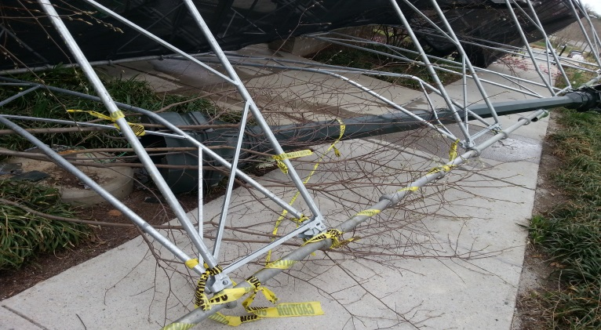
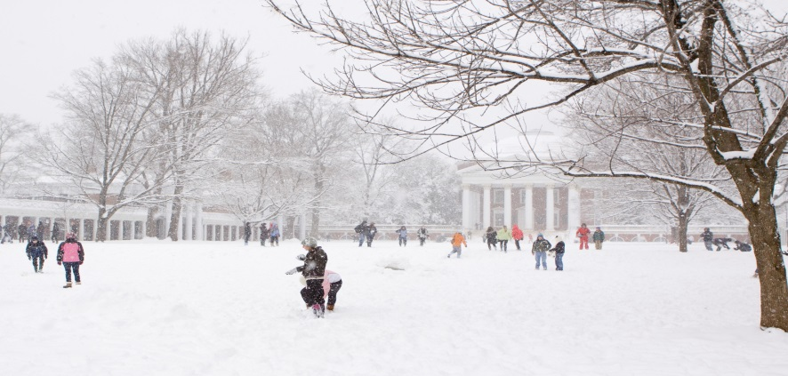
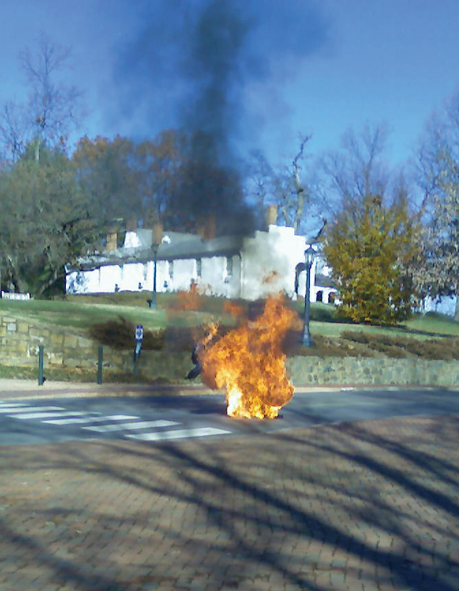

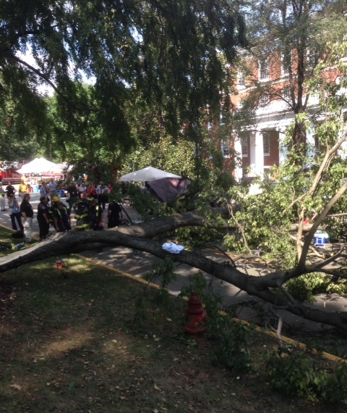
Emergencies can happen at any time…
Notes:
Emphasize why it is important to be prepared for emergencies. All pictures are of real incidents on Grounds

Slide 4
Prepare in Advance!
Preparing in advance allows you to respond quickly and safely. It will help to know:
  Your work space and what emergency resources are available
  How you’ll hear about an emergency
  How to get help
  What decisions you may have to make
  How to evacuate
  How to shelter in place
  Who your emergency contacts are and how to contact them
  How to stay informed
  How you’ll recover from an emergency
  How you’ll stay prepared to act
Notes:
Introduce this list as the list of topics we will cover in this presentation

Slide 5

10 Things to Know in an Emergency

Slide 6
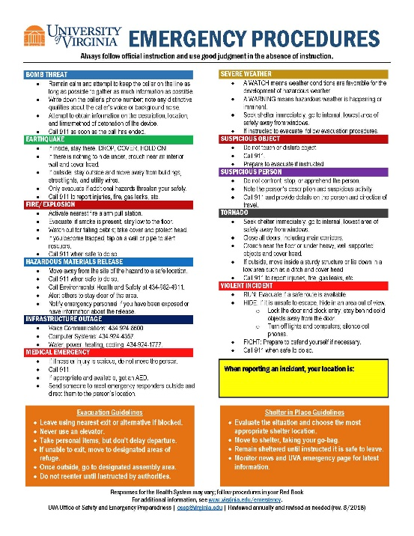
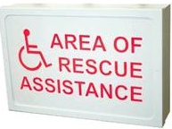
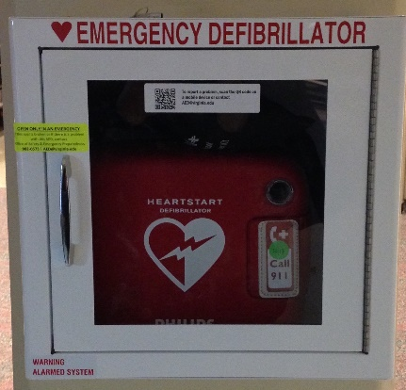
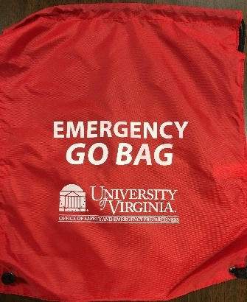
1. Know your space and equipment
Know your building
  Exit routes
  Areas of rescue assistance
  Shelter in place locations
  Assembly locations/rally point
Know your emergency supplies
  Automated External Defibrillator
  First Aid Supplies
  Emergency Procedures poster
  Emergency Kit/Go Bag
Notes:
Exit routes – Know where your exit routes are from dorms, classrooms, offices, etc (adapt to audience)
Areas of Rescue Assistance – Know where someone with a disability should go if they have trouble evacuating
Shelter in place locations – What is a good location for sheltering in place? What should one do when sheltering?
Assembly locations/rally points – If the building is evacuated do you know where you should rally? Refer people to building evacuation sites on our website
AED – Do you know where the closest AED is to your classroom/office? Note: Currently there are no AEDs in dorms. Total of 275 devices
First aid – Does your area have a first aid kit (note: these are NOT university sponsored)
Emergency procedures poster – Available on OSEP website
Emergency Kit – Will talk about on the next slide

Slide 7

Emergency Kit
Flashlight/extra batteries
First aid supplies
Dust mask
Poncho
Copies of important documents
Moist towelettes
Medications/prescriptions
Spare glasses
Bottles of water
Non-perishable snacks
Cash
Notes:
List items that should be included. Students are issued GO BAGS…we have plenty extras in the office

Slide 8
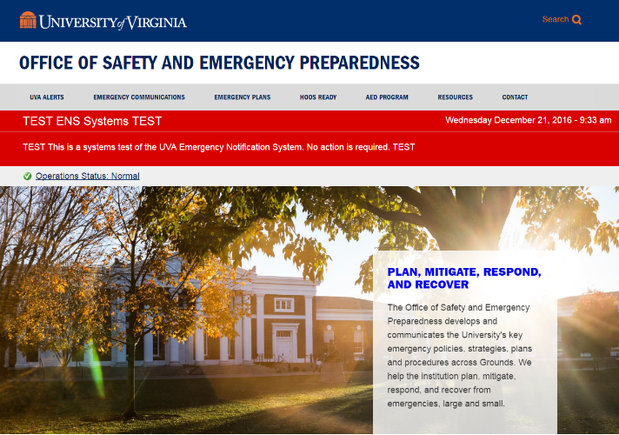
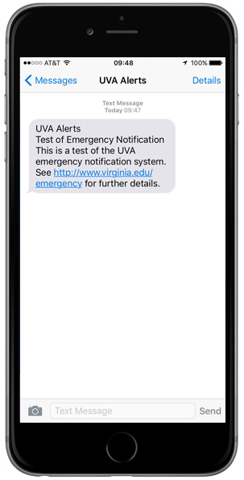
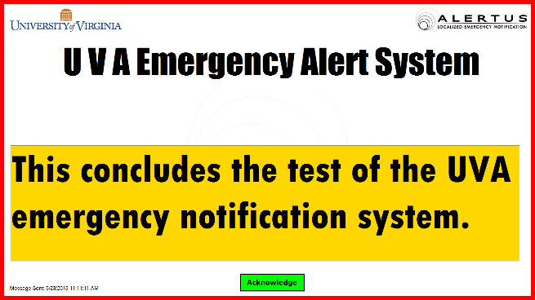
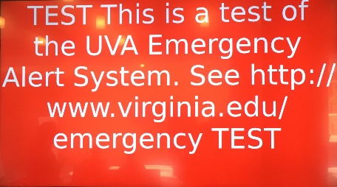
2. Know how you’ll hear about an emergency
UVA Alerts
  Text message
  Email
  Alertus Desktop Notification
  LED/LCD displays
www.virginia.edu/emergency
Siren/PA
Fire alarm
News media
Witness event (Call 911!)
Notes:
UVA Alerts – discuss opt-in vs emergency email system (everyone gets an email from the EES), must OPT IN for text and Alertus. Info on our website
Make note that the official source of information is OSEP website

Slide 9
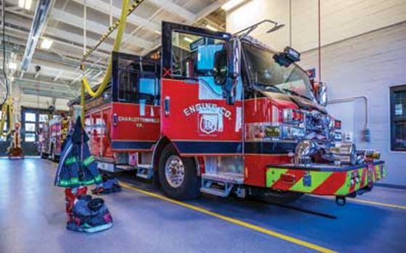
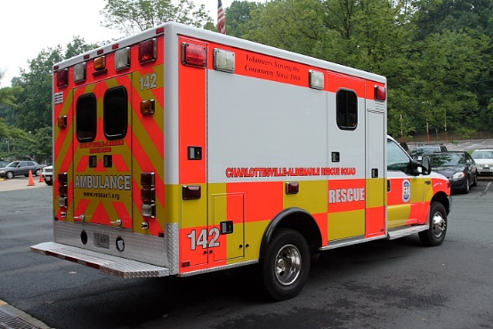

3. Know how you’ll get help
For any type of emergency, call 911
  Stay calm
  Give your name, address, and nature of emergency
  Stay on the line until you’re told to hang up
  Answer questions as clearly as possible – help is on the way
Notes:
Notes: Help is coming even while dispatcher is asking questions. UVA police dispatched to all calls on Grounds
Also note that the HS wants us to refer people to their red books…

Slide 10
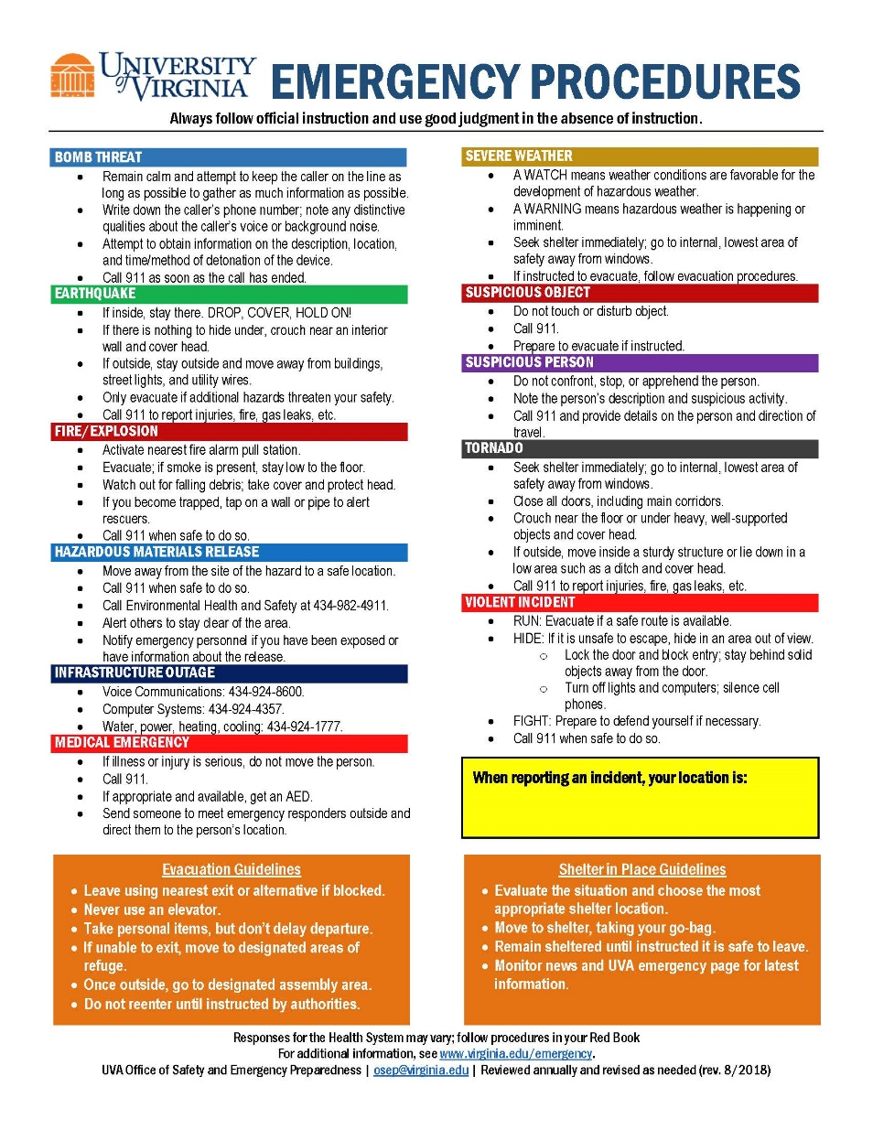
4. Know how you’ll react
Gather Information
Watch and listen for instructions
Follow instructions
  Evacuate = GO
  Shelter in Place = STAY
Sometimes you may need to use your best judgment
Notes:
Sometimes what you need to do is very clear, other times you may need to use your best judgement to STAY or GO. Poster available on our website.

Slide 11
5. Know how you’ll evacuate
DO
DO NOT
Secure hazardous materials
Take wallet/ID, keys, cell phone, emergency kit
Close doors
Walk to exits in an orderly manner
Assist persons with disabilities/special needs
Move to area of refuge if unable to exit
Report to assembly area
Lock doors
Waste time gathering belongings
Run
Use elevators
Go home/to vehicle without checking in at assembly area
Notes:
Review do’s/donts of evacuating. Emphasize closing doors, walking in orderly fashion, and going to assembly area

Slide 12
6. Know how you’ll shelter in place
DO
DO NOT
Secure hazardous materials
Grab emergency kit (go bag)
Move to shelter location
Close and lock doors
Turn off lights
Put phones on silent
Check in with family when safe to do so
Remain sheltered until instructed it is safe to leave
Leave doors open
Waste time gathering belongings
Run
Stay on phone
Notes:
Review do’s/donts of sheltering in place. Emphasize location dependent on event, phone on silent

Slide 13
7. Know your emergency contacts
Personal
  Spouse/significant other
  Emergency contact
  RA/Roommate
  Out-of-area contact
Professional
  Manager
  Colleagues
  Interdependent organization
  Residents/Resident Director
Notes:
ICE/Emergency feature of most modern smart phones, making sure you have contact info for those you may need to contact. Consider a secondary place (list in wallet or go bag) in the event your cell phone doesn’t work. Specific contacts may vary based on audience (i.e. parents/RA for students)

Slide 14
8. Know how to stay informed
UVA Emergency Webpage is official, most up-to-date source of information: www.virginia.edu/emergency
UVA Alerts
University Hot Lines (closings)
  243-7669
  924-7669
Local Media
  Emergency Alert System (EAS)
  Severe Weather
  Closings/Delays
  News Updates
EAS Radio Stations | EAS TV Stations
WCHV 1260 AM | WVIR Channel 29 (NBC)
WINA 1070 AM | WCAV Channel 19 (CBS)
WKAV 1400 AM | WVAW Channel 16 (ABC)
WWWV 97.5 FM (3WV) | WAHU Channel 9 (Fox)
WQMZ 95.1 (Z95.1)
WUVA 92.7 FM (Nash Icon)
WCYK 99.7 FM (HitKicker 99.7)
WHTE 101.9 FM (Hot 101.9)
WZGN 102.3 FM (Generations 102.3)
Notes:
Emphasize first point. Intermediate updates ONLY go to website. Hot lines/WTJU are for closings ONLY

Slide 15
9. Know how you’ll recover
An extended disruption may require continuity of operations (COOP) efforts
  COOP team member perform essential functions during critical events
  Learn about your unit’s COOP plan
Understand if you are a “designated” or “non-designated” employee
  Designated – Will report even if agency is closed. Know your roles and responsibilities, plan accordingly, and plan for your family’s needs
  Non-designated – Will not report if agency is closed. Know your roles and responsibilities and how to stay informed about the return to normal operations
Notes:
Focus message of this slide based on audience.

Slide 16
10. Know how you’ll stay up-to-date
Practice
  Talk through an emergency scenario with your friends and colleagues on a regular basis
  Evacuate with every fire alarm
  Practice sheltering in place during tornado and earthquake drills if able
Update
  Keep up to date on local hazards
  Make sure emergency contacts are current
  Reflect staff changes and building changes in your plan
Notes:
Emphasize importance of vigilance and practice. Message of slide may be tailored to audience. RA’s should be encouraged to talk through emergency procedures with their halls on a regular basis

Slide 18
Additional Resources
University of Virginia Emergency Management resources webpage
https://uvaemergency.virginia.edu/resources
LiveSafe Mobile Safety App
https://safetyandsecurity.virginia.edu/mobile-safety-app

Slide 19

Questions?
UVA Emergency Management
uvaem@virginia.edu | 982-0565

